Slide 1
Material compatibility

Slide 2
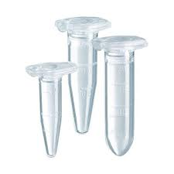
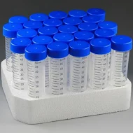
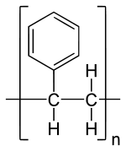
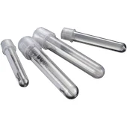
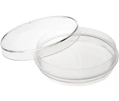
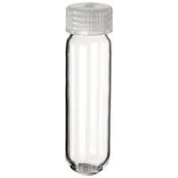
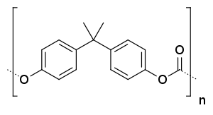
What are these tubes tubes made of?
Polypropylene
High chemical and thermal resistance (autoclavable)
Polystyrene
Cheaper clear plastic
Usually for disposable applications
Polycarbonate
High strength – high speed spins
Less chemical resistance

Slide 3
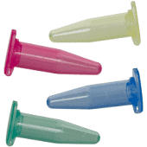
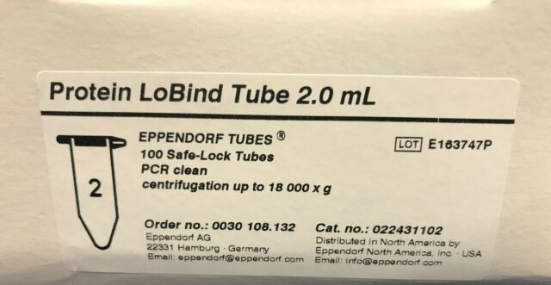
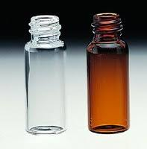
Sample preparation tubes
Color tubes
Can leech dyes
Don’t use for MS or optical measurements
Sterile
Irradiated (gamma radiation)
RNAse/DNAse free
Low retention (Lo Bind) tubes
Coated to bind less protein
Recommended for dilute protein solutions
Proteomic samples
Glass vials
Amber glass (light sensitive samples)
Silanized glass (coating)

Slide 4
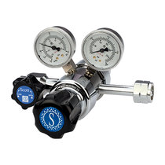
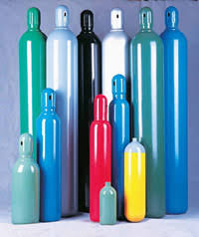
Gas cylinders & regulators
Brass
70% copper, 30% zinc
Stainless steel
304 - 18% chromium, 8% nickel
316 - 16% chromium, 8% nickel, 2% molybdenum
More corrosion resistance & more $$$
Gas purity
2.0 – 99%
4.0 – 99.99%
5.5 – 99.9995%

Slide 5
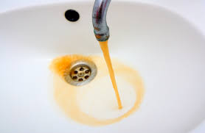
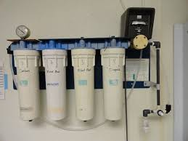
Water
Industrial water
Untreated (not potable)
Deionized (DI)
Reverse osmosis
One shared tank for the wing
MilliQ
Combination of UV irradiation, ion exchange, and graphite stages
Final step through 0.22 μm membrane
May still contain a lot of plastic polymers
Optima (LC-MS)
Removal of most polymers that show up on the mass spec
Optima UPLC grade (even lower levels of background)

Slide 6
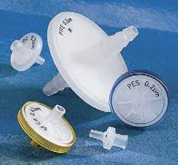
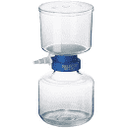
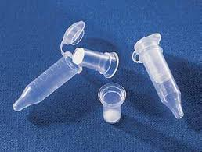
Filters
Pore size
0.45µm
0.22µm (very sterile applications) or MALS
Molecular weight cut-off (MWCO)
Chemistry
Polyethersulfone (PES)
Hydrophilic – low protein binding
Regenerated cellulose
Low binding, good chemical resistance
Nylon
Some chemical resistance, binds protein
Polytetrafluoroethylene (PTFE)
Good chemical resistance
Lookup Compatibility:
https://biomedical-innovations.com/Products/Syringe-Filters/Membrane-Compatibility.aspx

Slide 7
Useful Databases
Cole Parmer Material compability:
https://www.coleparmer.com/chemical-resistance
Plastics International database:
https://www.plasticsintl.com/chemical-resistance-chart
US plastics database:
https://www.usplastic.com/catalog/files/charts/LG%20CC.pdf
Thermo Fisher’s database:
http://tools.thermofisher.com/content/sfs/brochures/D20480.pdf

